Slide 1


This lecture, based on Chapter 2, covers:
THE MODEL OF PRODUCTION POSSIBILITY FRONTIER (PPF)
&
THE PRINCIPLES OF SPECIALIZATION
DR.DOWLAH/FALL2016

Slide 2

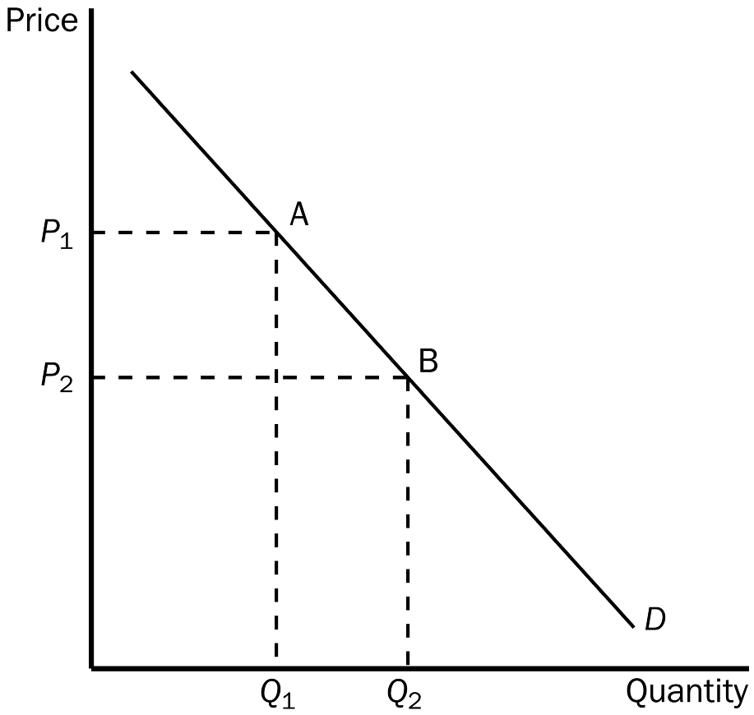
A graph shows relationships between two variables. We put the Independent variable on vertical axis (Y-axis) and Dependent variable on horizontal axis (x-axis). A downward sloping curve shows negative relationships between variables.
DR.DOWLAH/FALL2016

Slide 3
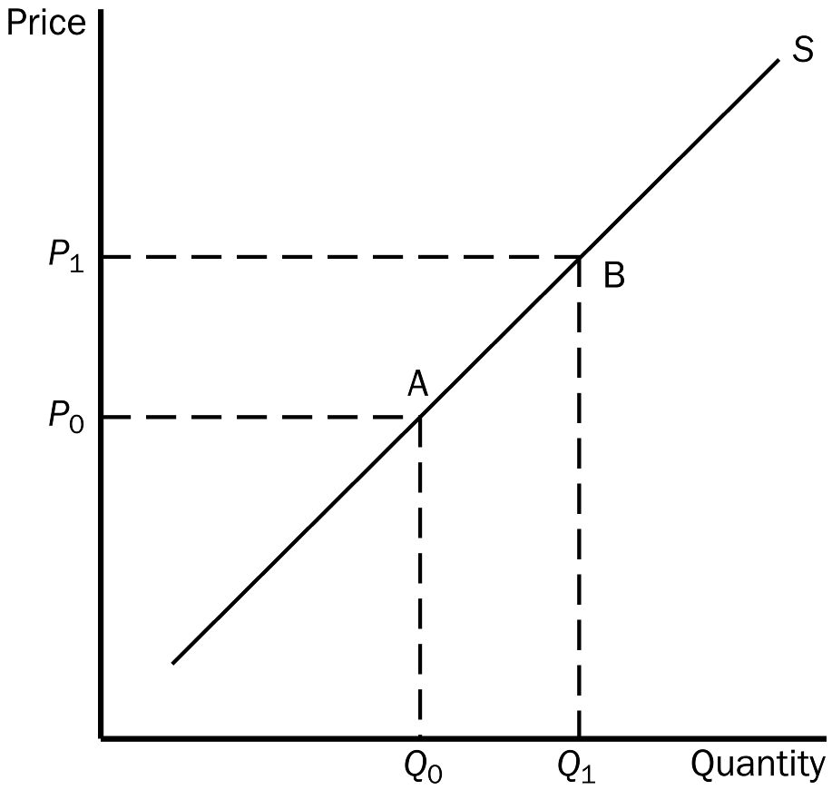
An upward sloping curve shows positive relationships between variables.
DR.DOWLAH/FALL2016

Slide 4

The production possibilities frontier (PPF) is a graph that shows various combinations of outputs that an economy can possibly produce given the available factors of production and production technology.
The PPF Model brings together the concepts of scarcity, opportunity cost, and trade-off that a nation confronts in allocation of resources.
DR.DOWLAH/FALL2016
Notes:
14

Slide 5

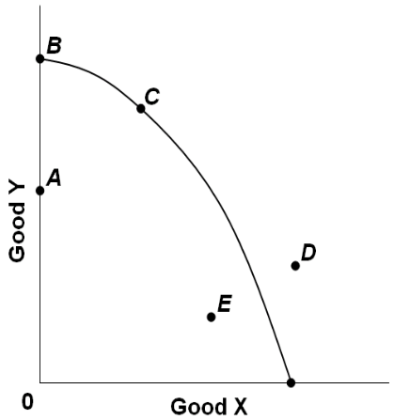
All points on the PPF are efficient. Efficiency implies full utilization of all factors of production.
All points outside the PPF are unattainable points, because resources of a country are not enough to produce at those points.
All points inside the PPF are inefficient—because resources are not fully utilized.
DR.DOWLAH/FALL2016

Slide 6

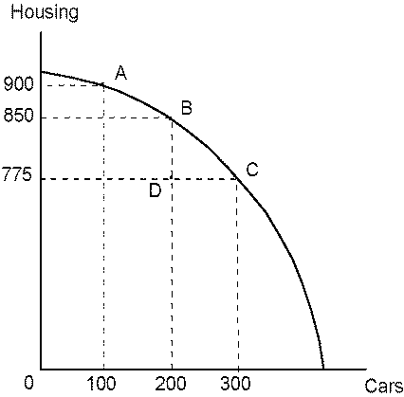
This graph shows production possibilities of Housing and Cars for a country.
What combinations of outputs the points A, B, C stand for?
DR.DOWLAH/FALL2016

Slide 7
The Law of Marginal Opportunity Cost
A unit of a good or service that must be given up to obtain an additional unit of another good or service.
Moving from A to B involves marginal opportunity cost of 50 Housing. Moving B to C involves marginal opportunity cost of 75 Housing.
That means, the more we are making cars, the more its cost in terms of housing, is increasing. This happens because of the Law of Increasing Marginal Cost.
DR.DOWLAH/FALL2016

Slide 8
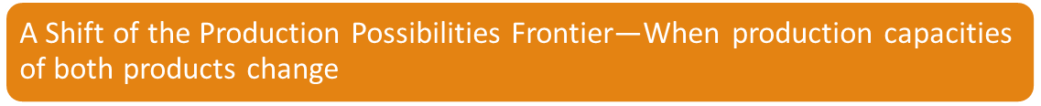
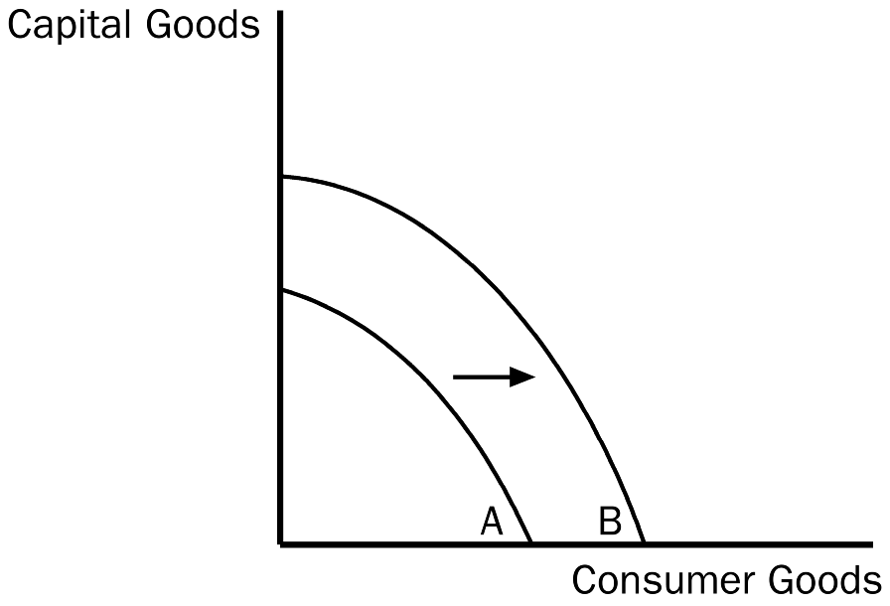
A Shift of the Production Possibilities Frontier to the right indicates positive economic growth. A shift to the left indicates negative economic growth.
DR.DOWLAH/FALL2016

Slide 9

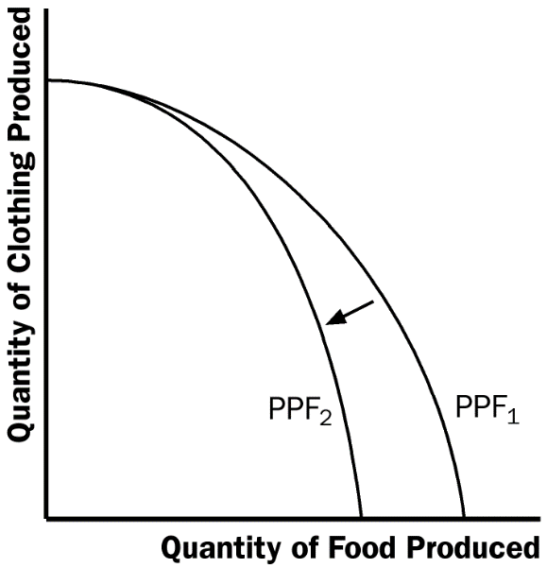
In this country, production capacity of clothing remained the same, but that of food has decreased. This is an example of rotation of the PPF.
DR.DOWLAH/FALL2016

Slide 10

Why individuals/countries specialize?
Why is interdependence the norm?
What determines specialization, production and trade of different countries?
DR.DOWLAH/FALL2016

Slide 11

A. The Principle of Absolute Advantage, given by Adam Smith, refers to productivity of an individual, firm, or nation compared to that of another. The producer that requires a smaller quantity of inputs to produce a good is said to have an absolute advantage in producing that good.
DR.DOWLAH/FALL2016

Slide 12
B. The Principle of Comparative Advantage, given by David Ricardo, refers to the ability of an individual, a firm, or a nation, to produce something with a lower opportunity cost than another individual, firm or nation.
DR.DOWLAH/FALL2016

Slide 13
Economics tells us to specialize where opportunity costs are lower.
Each country should specialize on the basis of its Comparative Advantage.
Similarly, each individual should specialize on the basis of the Principle of Comparative Advantage.
Everybody should specialize in a job for which his/her opportunity cost is lower.
DR.DOWLAH/FALL2016

Slide 14

Suppose there are only two people in an island—John and Jane. They both can make bread and catch fish.
John can make 15 bread or catch 45 fish in a day and Jane can make 45 bread or catch 15 fish in a day.
Who should specialize in Bread? Who should specialize in Fish?
The answer depends on who can produce fish/bread at a lower cost compared to the other?
DR.DOWLAH/FALL2016

Slide 15
Opportunity cost for making bread
John can make 15 bread or catch 45 fish. So, if he makes 1 bread, he sacrifices 3 fish.
Jane can make 45 bread or catch 15 fish. So, if she makes 1 bread she sacrifices 1/3 fish.
Jane sacrifices less for bread. So, Jane should specialize in bread.
DR.DOWLAH/FALL2016

Slide 16

John has to sacrifice 45 fish for making 15 bread. So, for 1 fish he sacrifices 1/3 of a bread
Jane has to sacrifice 15 fish for 45 bread. So, for 1 fish she sacrifices 3 bread
John sacrifices less for catching fish, so John should specialize in fish.
DR.DOWLAH/FALL2016

Slide 17

Before specialization, Global Production and Consumption capacities were 60 fish and 60 bread, but actual production and consumption were 30 fish and 30 bread.
After specialization, global production and consumption increased to 45 fish and 45 bread. The world is better-off. Specialization allows countries to produce and consume beyond their original PPFs.
DR.DOWLAH/FALL2016

Slide 18

As countries produce on the basis of comparative advantage, they produce at a lower cost compared with other nations.
Other nations find it advantageous to import those goods as it is cheaper to buy those than produce those goods at home. Thus, mutually advantageous trade benefits all nations.
Also, specialization and international trade promotes competition, innovation, lower-cost production, and greater consumption.
DR.DOWLAH/FALL2016

